Slide 1

Air Traffic Controller Cyberattack Evaluation Serious (ACES) Game
Final Presentation – May 9th, 2014
Doran Cavett, Will Fontan, Imran Shah
Sponsor: Dr. Paulo Costa (GMU C4I Center)
SE/OR 699

Slide 2
Outline
Problem Statement
Technical Approach
Deliverables
CONOPS
Architecture
Requirements
Software Integration
Findings & Recommendations
Project Validation
Proposed Way Forward
Unity Proof of Concept Demo

Slide 3
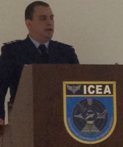
Definition and Background
Serious Game: Simulation of real world situation intended to develop new experience, insights and knowledge.
The GMU Command, Control, Communications, Computing, and Intelligence (C4I) Center has been working on assessing the impact of cyber attacks on critical infrastructure.
  Expanding on PhD work of Brazilian Air Force LtCol Barreto. Our sponsor Dr. Costa was a member of LtCol Barreto’s PhD committee.

Slide 4
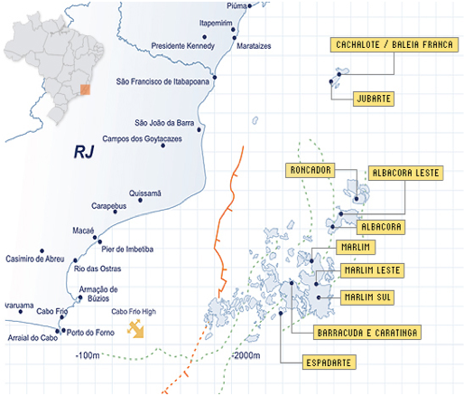
Scenario
Campos Basin - petroleum rich area located in the Rio de Janeiro state
Responsible for 80% of Brazil's petroleum production
Oil operations include heavy helicopter traffic between the continent and oceanic fields.

Slide 5
Helicopter Tracking

Slide 6
Problem Statement
Disruption to operations has the potential to bring oil production to a halt
ADS-B is vulnerable to cyber-attacks
ATCs need to be able to recognize and respond to cyber-attacks and currently there is no system in place to do so

Slide 7
Technical Approach –
Serious Game
Develop a Serious Game that simulates helicopter operations in support of oil production in the Campos Basin Region
Game will be played by an Air Traffic Controller.
Goals:
  Identify cyber-attacks and minimize disruption to operations
  Understand impact to critical infrastructure
A Serious Game provides a cost effective engaging solution where players can take risks without harming assets or life

Slide 8
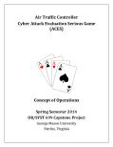
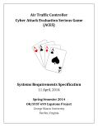
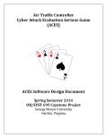
Deliverables
Graduate SE/OR Team:
  Concept of Operations (CONOPS)
    Frame the problem
    Describe characteristics of game from end user perspective
    Define the solution for the game
  System/Subsystem Specification
    Subsystem Requirements
    Software requirements for the game
  Software Design Document
    Initially focused on integration of VR-Forces simulation tool and Unity game engine
Undergraduate Simulation and Game Institute (SGI) Team:
  Proof of Concept Serious Game

Slide 9



Policies, Assumptions, Constraints
Policy Assumptions
  GMU/SGI standards, policies and best practices
  Best practices fostered by the U.S. Entertainment Software Association
  The Entertainment Software Rating Board (ESRB) rating for ACES should be ADULT
General Assumptions
  First Version – operational at GMU C4I Center and SGI Development Center.
  Technical Support - GMU C4I Center and SGI Development Center.
  Logistics – GMU SEOR & SGI
Notes:
The following two slides captures the environment and circumstances in which ACES must operate.
We have Policies and Guidelines coming from the Institute itself, along with video games design and development Best Practices fostered by the US Entertainment Software Association (e.g. those dealing with intellectual property & anti-piracy – content protection features, and pro-family games – parental controls & ESRB rating system)
WRT General Assumptions:
ACES first prototype would need to work from the C4I Center and SGI development facilities.
Also, all IT tech support would be provided the SGI team and/or our our sponsors at the C4I Center.
Finally, any logistical support would be provided by either the SEOR team and/or the SGI D2 team.

Slide 10
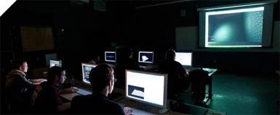

Policies, Assumptions, Constraints (2)
Constraints
  The system shall leverage from existing C4I Center and SGI’s hardware, server, and development tools
  Interoperability and interface requirements shall be set by SGI development team
  The system shall leverage from the C4I Center’s C2 Collaborative Testbed
Notes:
As far as constraints we are concerned,
We were asked to leverage from a number of S/W tools our sponsor owns (mostly Commercial-of-the-shelf (COTS) products and we’ll get to describe these tools in later slides).
The same applies what’s available - H/W and S/W – at the SGI facilities.
Of course, both of these desires will lead to a series of explicit and derived interoperability and interface requirements future SEOR-SGI teams would need to uncover

Slide 11
Operational Concept
Major actors: The User (Player) and ACES
The intended audience: Air Traffic Management (ATM) personnel; particularly, the ATC
Every aspect of the game will involve the graphical user interface (GUI) in order for the User to progress or influence the gameplay
The User will launch the application, create / delete /edit accounts, and play the ACES game
User will be visually challenged with two-dimensional and 3-dimentional entities mapped on the screen.
User’s response will be achieved via use of the mouse and/or clicking on keys on the keyboard
Notes:
The Operating Concept is quite straight forward and characteristic of a video game:
You have a user (aka the player) and the game (ACES)
The targeted audience is the Air Traffic Management personnel, in particular the ATC (as mentioned earlier)
Similar to a traditional video game, the player creates and account and logs in to play the game.
The player is confronted with a series of cyber threat scenarios he or she is expected to respond in a timely fashion to eliminate or mitigate the threat

Slide 12
Proposed Metrics
Capability | Attribute | Measure | Metric
Attack Detected and Positively Identified | Attack Characteristics and Pattern | Attack Type, Target, and Technique | Quantity detected; % detected; % positively identified
Identified attacks quarantined | Number of Affected Devices and Response Time | Number of consoles quarantined and recovered | % of ATC consoles recovered; Time of recovery
Recovery to Attack Event | Computer Terminal Down Time | Time to full recovery from attack | Time to recovery
Mission Assurance | Flight operations to and from Oil Platforms | Operations Tempo | Sortie Generation Rate; Average mission fuel consumption; Average mission flight time
Mission Assurance | Flight operations to and from Oil Platforms | Mission Reliability | % of flight operations successfully completed
Schedule Adherence | Late Flight Departures and Arrivals | Schedule Slippage | % of late departures & arrivals; average late departure and arrival times
Notes:
While drafting the CONOPS document, the team engaged in high-level scoring discussions which eventually led to the creation of this table, as possible metrics for the game.
Dr. Barreto found it very relevant and timely and suggested we expand it to include operational capabilities/attributes (in addition to cyber-attack elements).
NOTES:
Recovery: threat has been detected, positively identified, and prescribed recovery procedures have been implemented.
Quarantined: cyber threat has been removed from the ATC’s console.
Mission Reliability: probability of completing entire sortie without failure of any Mission Essential Function.

Slide 13

Storyboards
Creating New Account and ACES Tutorial
  Account setup and registration; first time tutorial
Launching ACES
  The Opening Sequence and Starting a game
ACES Cyber-Attack Injects
  Type, amount, rate, duration = difficulty level
ACES General Description & Normal Operational Tempo Guidance
  Normal flight OPS; game duration
Airport
Outbound Air Corridor
Inbound Air Corridor
Oil Platforms
Notes:
We developed a series of Storyboards to promote dialogue between the SGI team, our sponsors, and us at an early stage of our effort.
Those developed – such as Launching the ACES Game and how we envisioned cyber attacks being injected into the game – were representative of the range of activities the user would be encountered with while playing ACES.

Slide 14
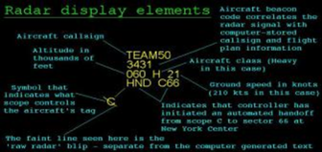
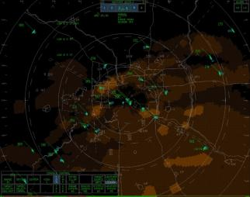
Storyboards
ACES Scoring / Point / Rewards System
  Flight time, fuel consumption, disruption to OPS cost, # of false tracks ID
Ghost Track Behavior
  Appearing, disappearing, abnormal speeds and heights, no confirmation
ACES Levels of Difficulty
  First – Easy; Second - Harder
Capturing Lessons Learned / Trend analysis
  Time, fuel, safety tradeoff analysis
ACES Graphical User Interface
  ATC Display/Console Description
Notes:
And here are the remaining five.
For the Level of Difficulty Storyboard, we introduced the idea of 2 levels of difficulty (easy and a difficult level) and what aspects of a cyber attack (e.g. duration, amount of simultaneous / near simultaneous attacks, and potential operational impact) would make the game easier or harder to play.

Slide 15
Architecture
GUI
GIS data mapped to
3-D entities
UNITY DE
Attack Generator
GIS Data
Environmental Models
GIS data
MAK
VR-FORCES
ATM commands
Data Exchange
Stop/Resume/Quit Game
Simulated Cyber-attack / IT effects
Attack / IT Data Output
Data Exchange
Import Account Data
DATA STORAGE
Export Account Data
Register Account Data
Notes:
This is our Architecture. ACES functionality is organized into five major subsystems.
First, every aspect of the game will need a GUI in order for a user to progress or influence the gameplay.
(Mak) VR‐Forces is a Computer Generated Forces (CGF) application and toolkit. It provides an application (with a GUI) that displays a simulated environment.
Unity is a Commercial Off-the-Shelf (COTS) game development engine and Integrated Development Environment (IDE) used create interactive 3D and 2D content, enhancing the visual aspect of ACES.
the VR-Forces interfaces with Unity in order to accept environmental model updates to the Geographical Information System (GIS) data that comes preloaded with the tool.
Once built, these enhanced models inside of Unity will be integrated to VR-Forces and mapped to object instances so that the visual aspects of the game are appealing to the user.
The Attack Generator was developed by LTC Alexandre Barreto, Brazilian Air Force, PhD, and it injects simulated cyber attacks and IT effects into the VR-Forces SS.
Finally, The ACES Data Storage Subsystem consists of two components; the Database for storage and quick recall of user profile information and the Data Store that contains the functionality to write game save information to a client machine.

Slide 16
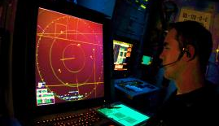
Requirements Development
Started with an idea and formed it into a vision through the CONOPS.
From there we broke down the desired functionality into ~20 high level requirements.
The 20 high level requirements were then turned into ~120+ system level requirements.
  Starting with 20 and ending around 120 gave us a 6 to 1 ratio on requirements development.
Requirements were developed for each subsystem.
  GUI contained the most requirements ~50 since it deals with user interaction and gameplay feedback.

Slide 17
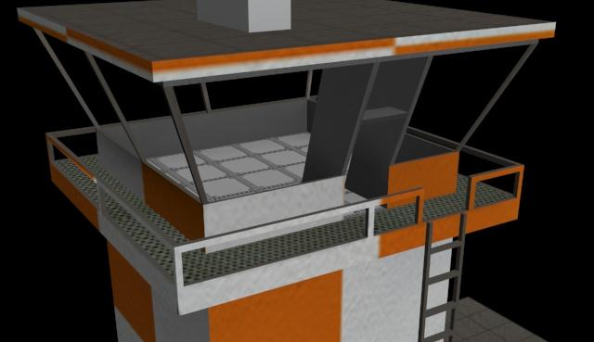
Subsystem
Requirements
GUI Examples:
  Functional Requirement: The system shall display helicopter flight path information in the form of a RADAR display.
    Derived Requirement: The ACES GUI shall update active helicopter flight paths at least every 1 second.
    Derived Requirement: Each aircraft displayed on the ACES GUI shall have its airspeed displayed in knots .
UNITY Examples:
  Functional Requirement: The system shall interface with Unity.
    Derived Requirement: The system shall accept 3-Dimensional (3D) models created in Unity.
    Derived Requirement: Commands received from within the Unity gaming environment shall manipulate the gameplay.

Slide 18
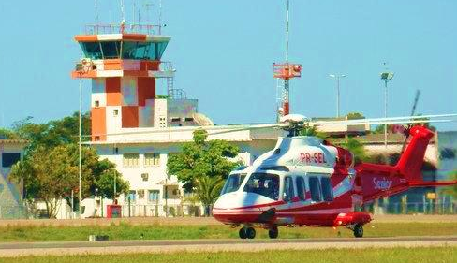
Subsystem
Requirements
Data Storage Examples:
  Functional Requirement: The system shall maintain profiles for at least 10,000 unique players and their gameplay statistics.
    Derived Requirement: The Database shall store players’ cyber-attack identification rates.
    Derived Requirements: The Database shall store gameplay statistics for each unique profile.
VR-Forces Examples:
  Functional Requirement: The system shall interface with VR-Forces.
    Derived Requirement: VR-Forces shall integrate with Unity to accept 3D and 2D visual models to enhance the gameplay environment.

Slide 19
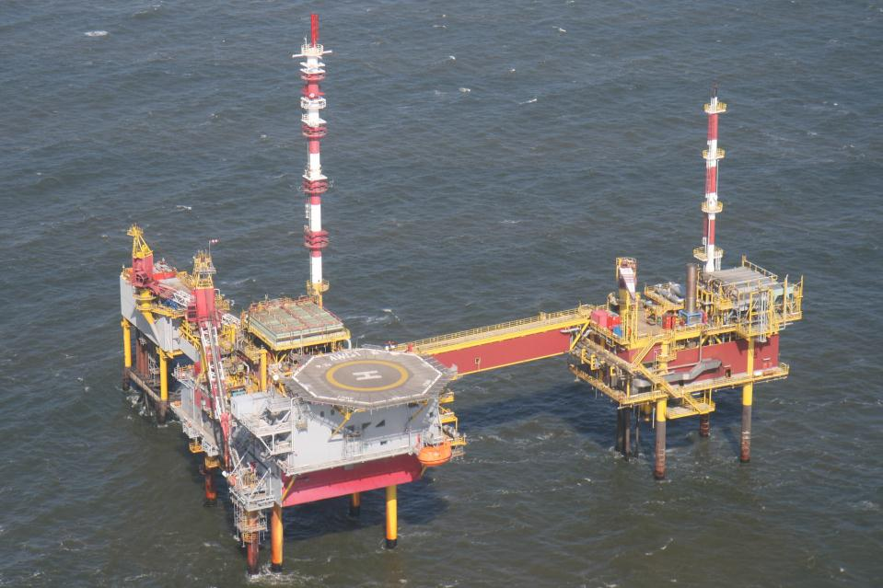
Subsystem
Requirements
Cyber-Attack Simulation Examples:
  Functional requirements were developed for each type of attack: Injection, Interception, and Jamming
    Functional Requirement: The system shall have an extensible Cyber-Attack Simulation engine that can define, construct, and distribute simulated cyber-attacks to Unity.
      Derived Requirement: The ACES System shall provide a user programmable script that allows a user to define new injection cyber-attacks.

Slide 20
Integration of Unity and VR-Forces
3 software components were involved with the integration prototyping:
  VR-Forces
  Unity
  VR-Link for Unity
Unity
GameLinkCS
C#
VR-Link
C++
GameLink
VR-Forces

Slide 21
VR-Forces & Unity
Interaction
Source | Destination | Data Exchanged | Desired Result | Feasibility
VR-Forces | Unity | Position of VR-Forces simulation entities | Display VR-Forces simulation entities in Unity game | Supported though VR-Link for Unity as described in sections 6.1.1 – 6.1.9 of the SDD
Unity | VR-Forces | Player interaction with VR-Forces simulation entities | Change in movement/operation of VR-Forces simulation entities | Unsupported directly. Workarounds exist
VR-Forces | Unity | Scoring: Landing of helicopters / Near accidents / Violation of helicopter operation rules (too high, too low, too close to others) | Provide data to allow for scoring of player | Captured purely in Unity and supported though VR-Link for Unity as described in sections 6.1.1 – 6.1.9 of the SDD

Slide 22
Unity Interaction with VR-Forces
Two types interaction types are available in VR-Forces:
  Pre-defined tasks
    Some examples: Move to an object, Fly to a heading, Take-off and land
    New tasks can be added by writing scripts in the Lau language
  Reactive tasks
    These are similar to If/Then scripts that monitor the simulation and execute if conditions are met.
    These can once again be defined by a developer and added to VR-Forces.

Slide 23
Findings / Recommendations
Integration
  Finding: Unfortunately VR-Link doesn’t allow for direct manipulation of VR-Forces entities from Unity.
  Recommendations: Reactive Tasks could be built for when a VR-Forces entity’s behavior requires modification. Suggested approach is to use the indirect means of using Reactive Tasks through Unity. An idea for implementation is to build a Control Panel Interface for the Air Traffic Control in Unity that would trigger the Reactive Tasks.
CONOPS
  Finding: a wide range of tradeoff opportunities between confronting a cyber-attack (IT Risk) and ensuring continuity of critical operations (operational Risk)
  Recommendation: a deeper look into this area is merited. Consider interviews / questionnaires / surveys to a group of ATCs to understand the tradeoff rationale between these two mutually related areas.

Slide 24
Validation
Sponsors
  Dr. Costa (C4I Center)
    Reviewed all deliverables and provided feedback
    Weekly Progress Reports
    Regular Teleconferences to discuss issues and obtain direction
  Dr. Laskey
    Reviewed all deliverables and provided feedback
    Weekly Progress Reports
Stakeholders
  VR-Forces Tech Support
    Provided guidance on approach towards integration of Unity and VR-Forces
  SGI Team
    Weekly teleconferences – Incremental approach towards design and requirements for POC
    Reviewed Proposal, CONOPS, and Requirements

Slide 25
Way Forward
Game Improvements
  Display Barreto Simulation of helicopter operations in the Unity designed game
  Implement suggested method for influencing VR-Forces entities from Unity.
  Develop game point/win-lose methodology and learning trend analysis tool
ATM Cyber Network Defense Toolset
  Develop behavior-based attack detection, counter-attack, and inoculation of ATC workstations tools
  Develop Network attack data collection, data analysis, and future attack prediction tools
Develop Future Operational Concept and Tactics Techniques & Procedures (TTPs) to evaluate with ACES
Notes:
Suggest approach is to use the indirect means of using Reactive Tasks through Unity is the recommendation for future teams.
An idea for implementation is to build a Control Panel Interface for the Air Traffic Control in Unity that would trigger the Reactive Tasks.

Slide 26
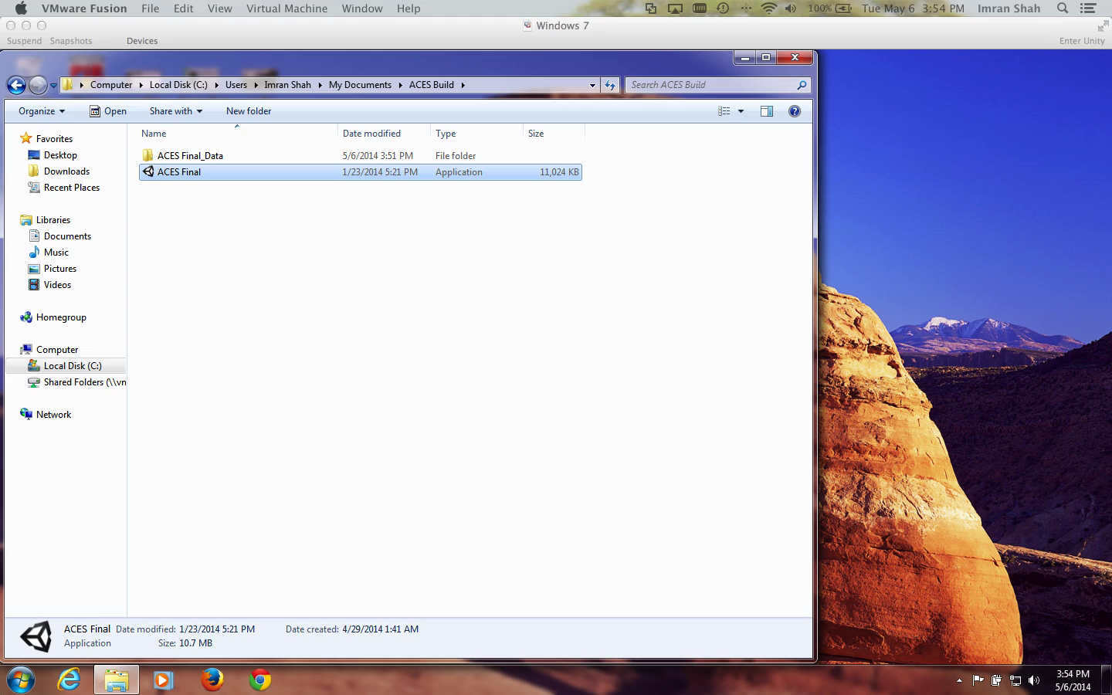
Proof Of Concept

Slide 27
Questions/Feedback

